Slide 1


Welcome
to the
Nathan D., Glenn D., Joyce H., Angelica W.
Multiverse

Slide 2
Mission Statement
To Expose language learners to nuanced Practice Environments through an immersive virtual cultural language experience.
Notes:
To help language learners embrace mistakes as positive and good for growth through an immersive virtual cultural language experience.
To Expose language learners to Realistic Practice Environments through an immersive virtual cultural language experience.

Slide 3
Problems
The natural goal for learning a new language is connection and communication, but traditional language learning methods focus on the means to and end, and not the end goal itself. practicing a foreign language becomes tedious because intrinsic motivations are too abstract.
practicing with traditional methods (i.e. classes and apps) leaves users underprepared for real-world interactions, which leads to embarrassment and miscommunication.

Slide 4





Solution
MultiVerse
A VR world that immerses a user in realistic, culturally aware, scenarios that evoke nuanced and goal-oriented learning experiences

Slide 5
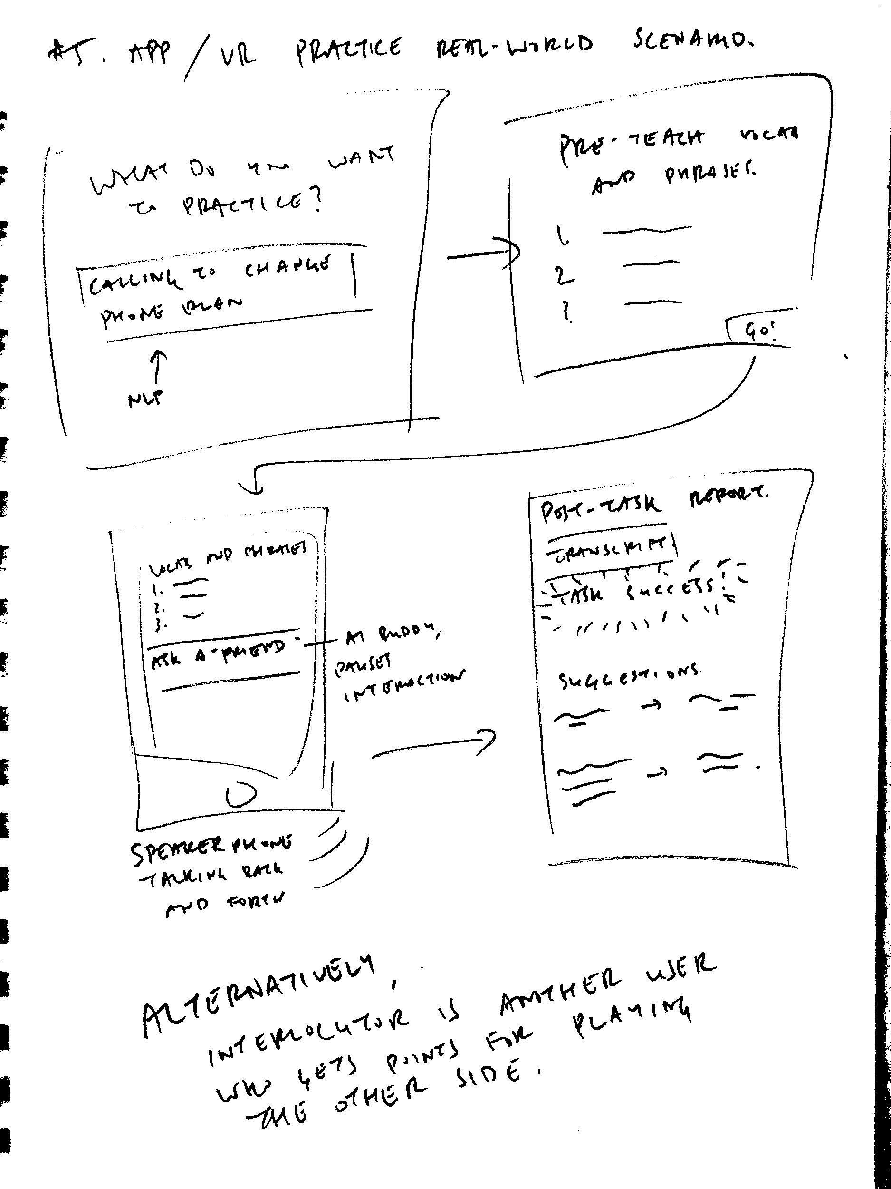
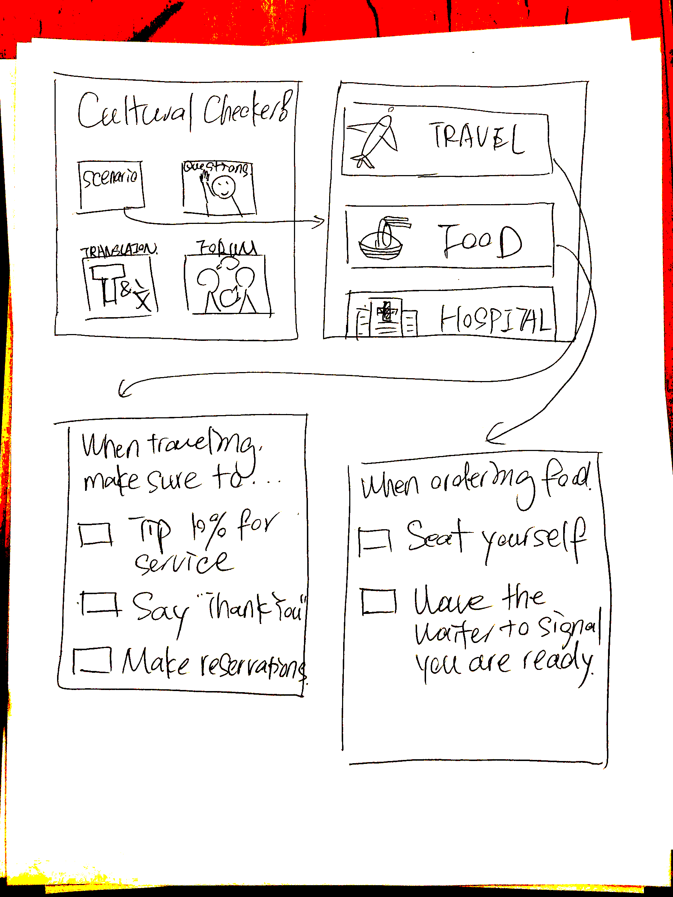
Concept Sketches

Slide 6
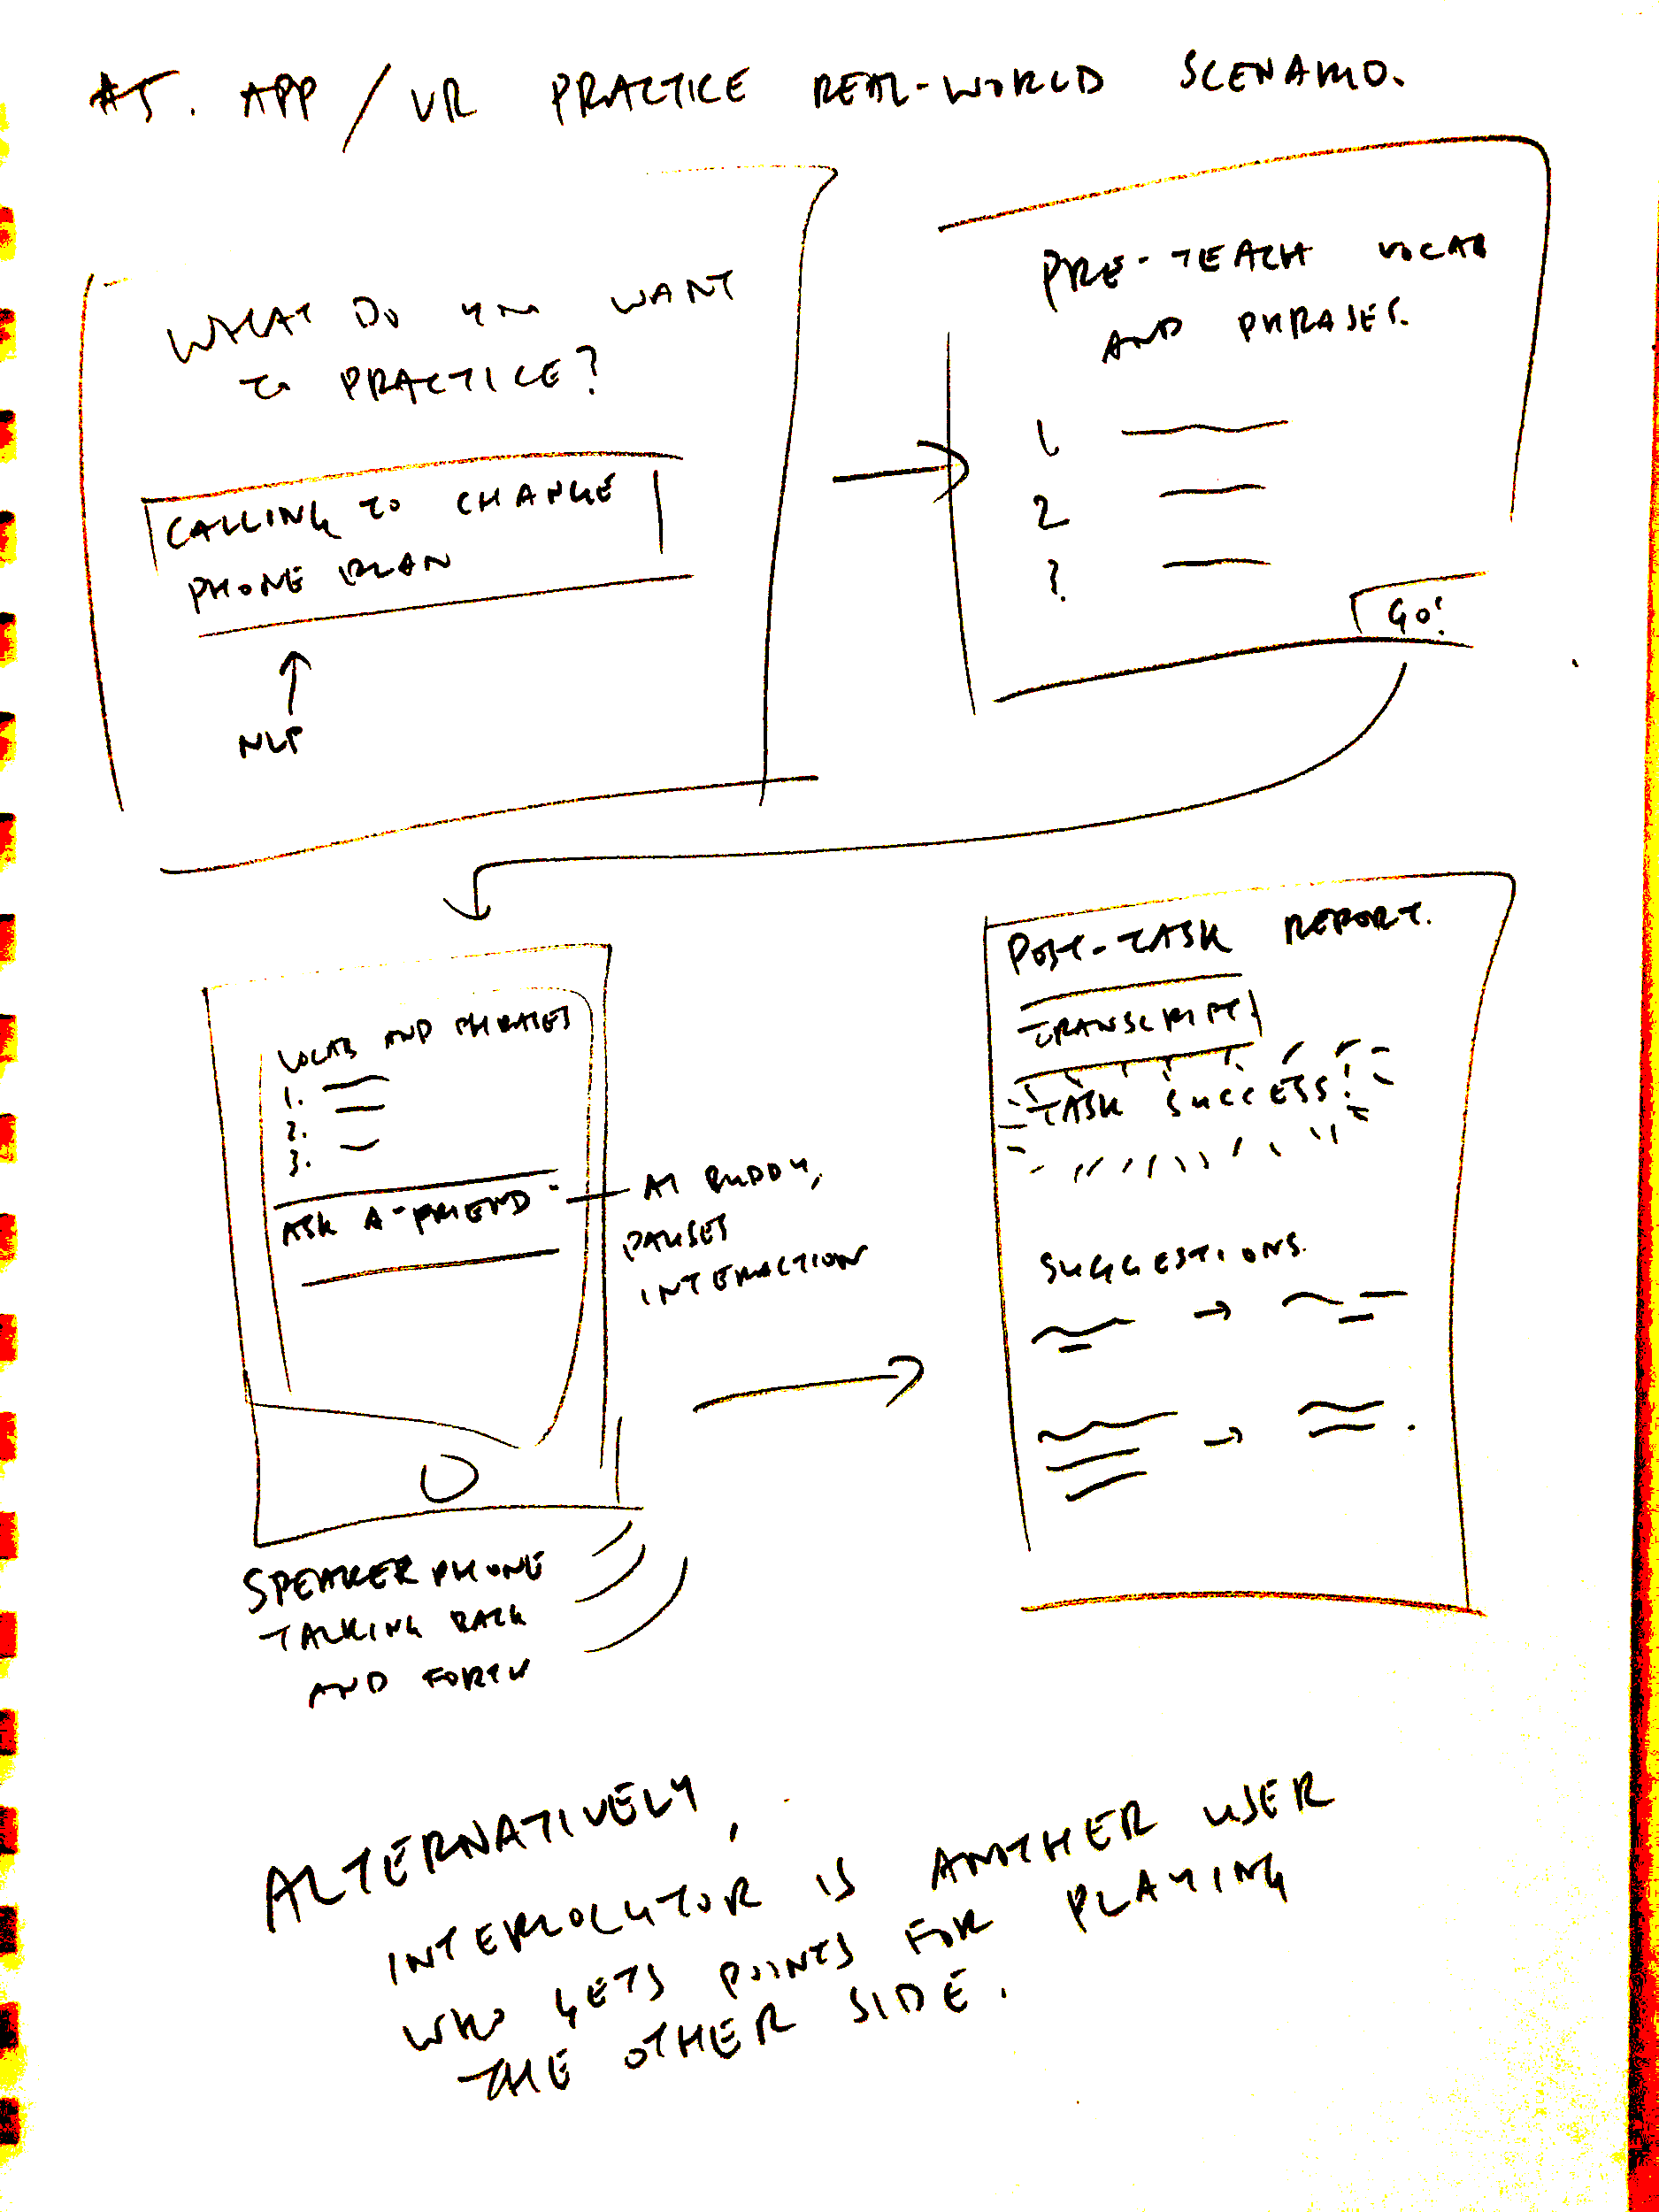
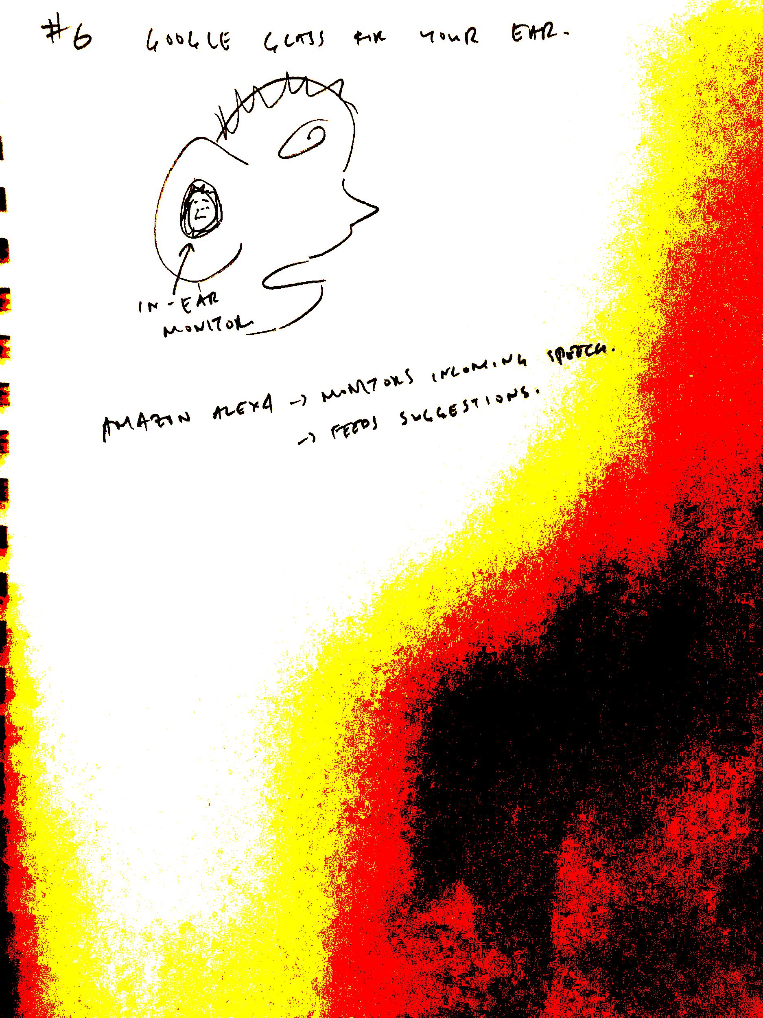
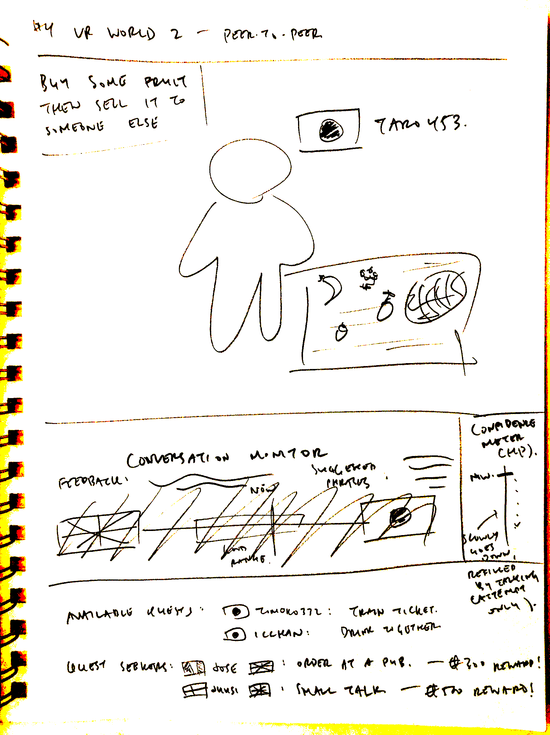
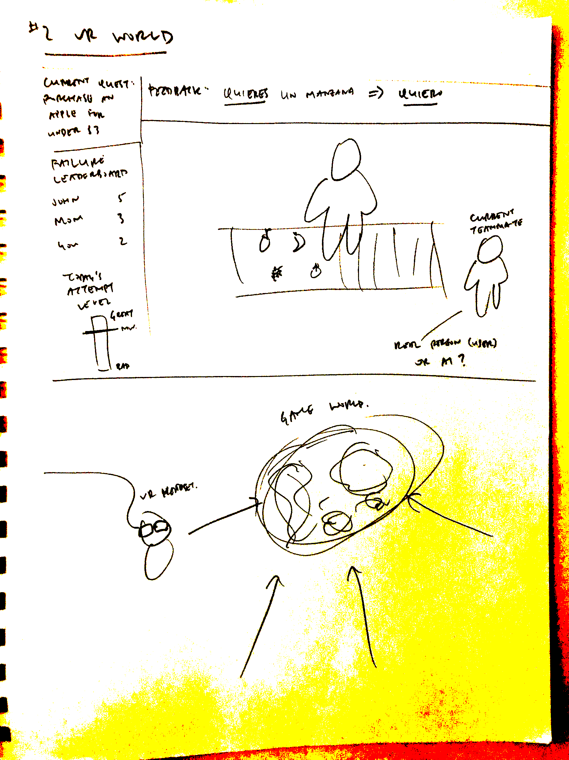
Concept Sketches

Slide 7
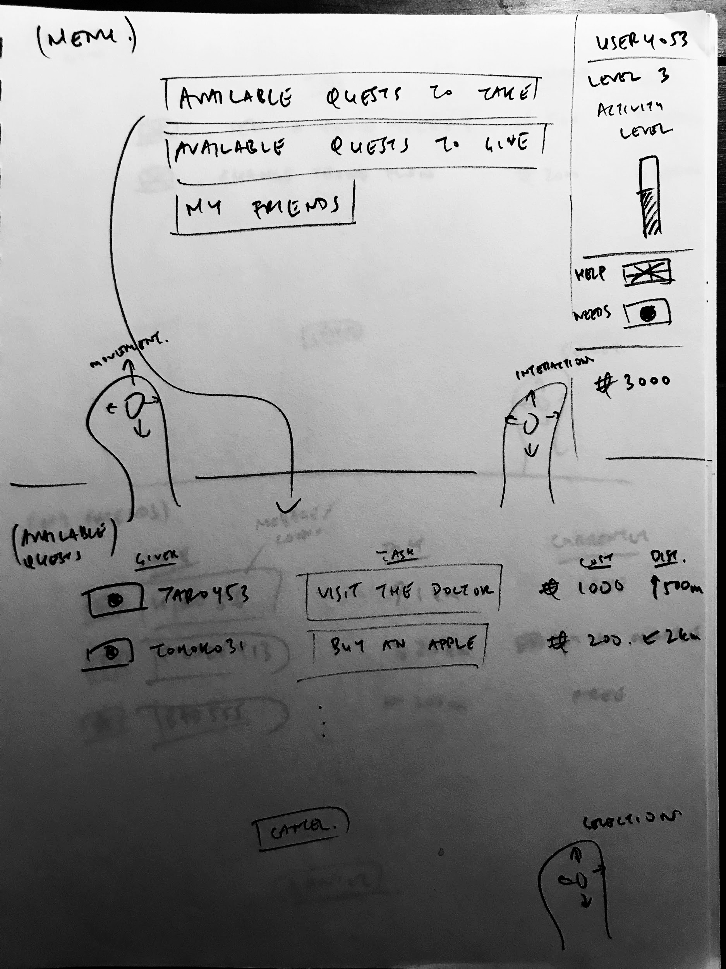
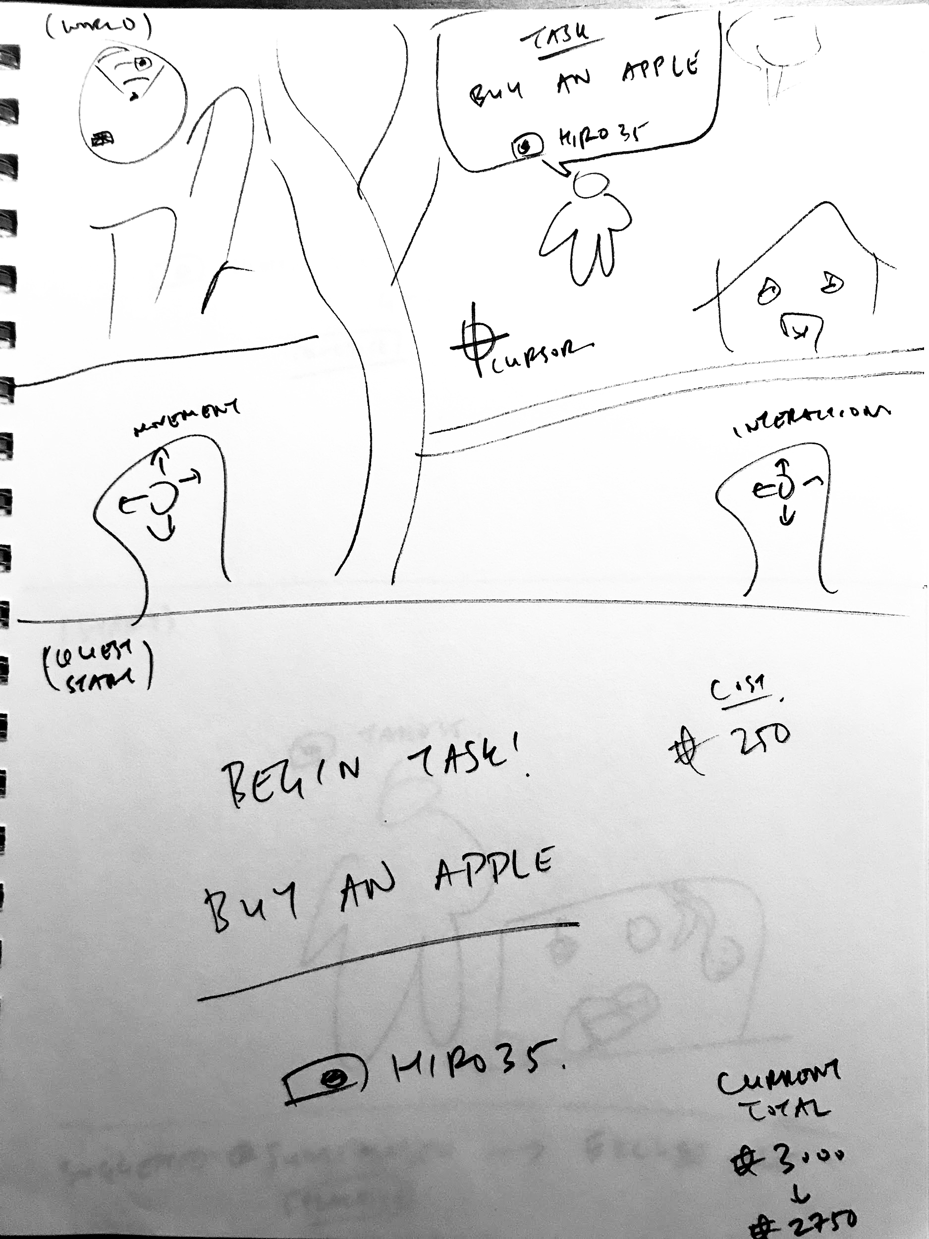
UI Sketches
User can either be an “expert” or learner in a scenario

Slide 8
Design Selection Rationale
multiVeRse
Pairs up language learners across languages (e.g., User 1 is native English speaker, learning Chinese, User 2 is native Chinese speaker, learning English)
Practice simulated real-world tasks with real speakers of that language
Given a reward (in-game currency) to provide the task, pay currency to be the learner in the task
Language support for pre-teaching vocabulary and phrases to use in the task
AI language support for feedback during and after the task is finished: monitoring conversation/task
Pros:
Real interactions in the target language with experts (native speakers)
No need to build out complicated intelligent tutor; interacting with other people instead
Cons:
May be difficult to get a balance of users with matching native/target languages
Notes:
Pros:
Real interactions in the target language with experts (native speakers)
No need to build out complicated intelligent tutor; interacting with other people instead
Cons:
May be difficult to get a balance of users with matching native/target languages

Slide 9
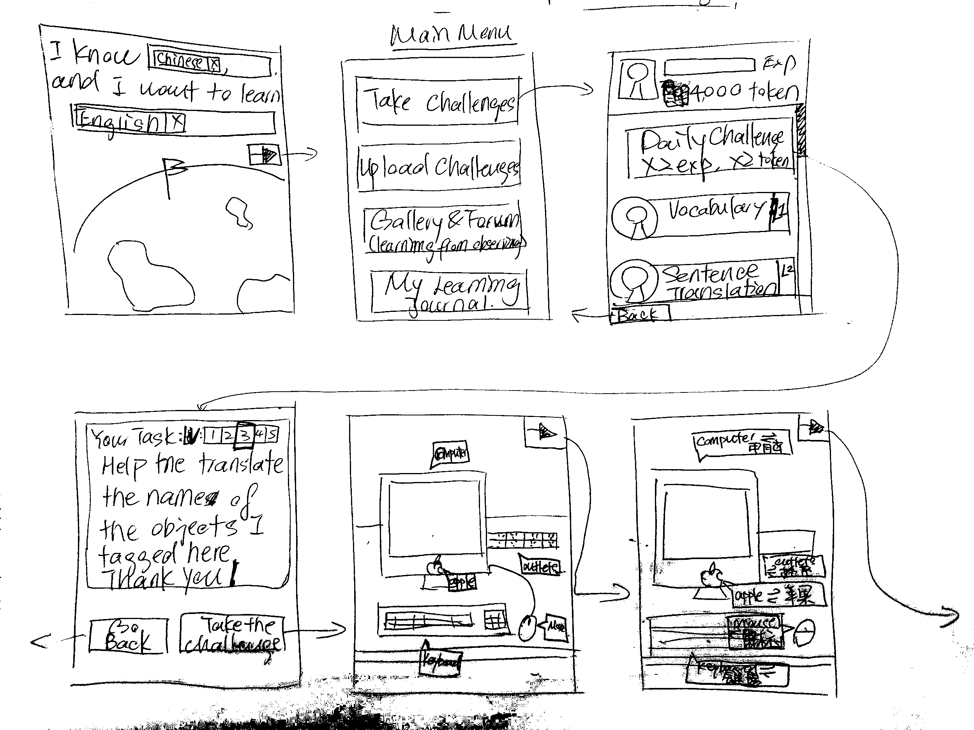
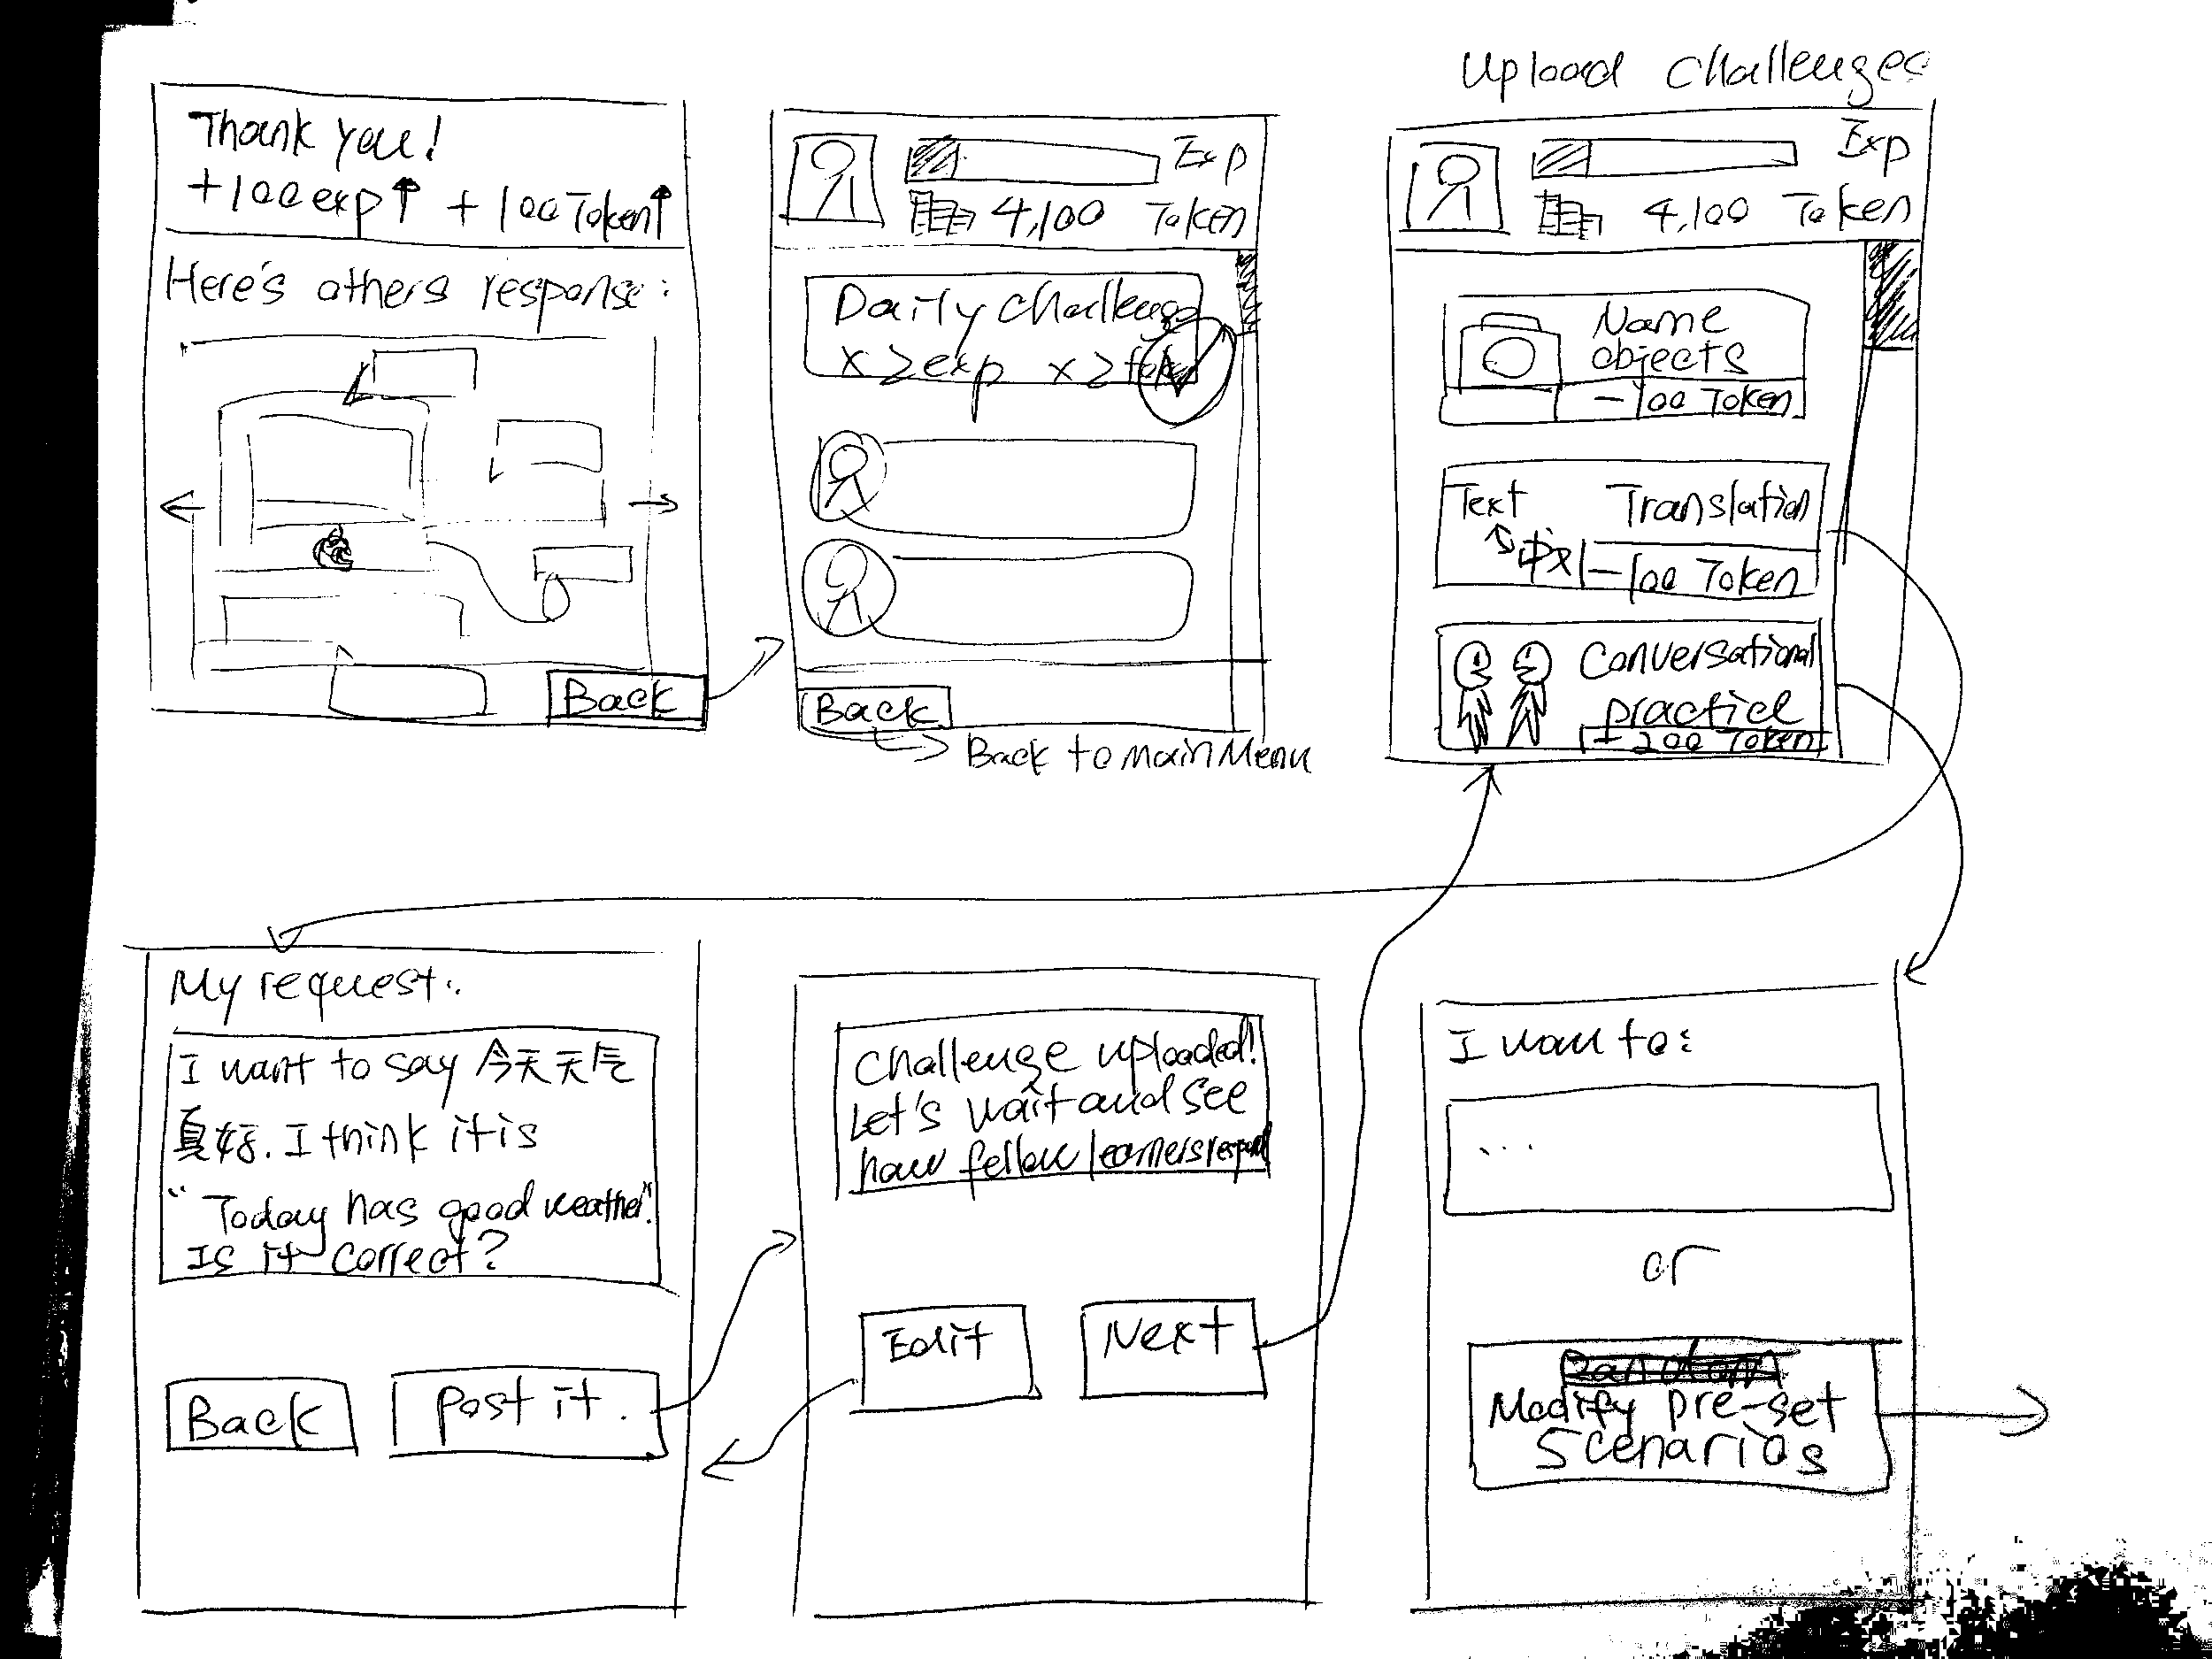
UI Sketches

Slide 10
Design Selection Rationale
Collaborative Quests (AR)
Matches users who have different native languages but are learning the same language (similar learning level)
Pros:
Goal oriented
Have different modules for different learning goals: conversational and vocabulary learning
Can crowdsource quests and challenges
Cons:
Not very context dependent
Does not focus on culture
Notes:
Idea 2: Collaborative Quests
Matches users who have different native languages but are learning the same language (similar learning level)
Pros:
Goal oriented
Have different modules for different learning goals: conversational and vocabulary learning
Can crowdsource quests and challenges
Cons:
Not very context dependent
Does not focus on culture
Need different storylines & quality of experience subjective to the quality of the storyline
1. Learners specify the languages they want to learn. 2. Learners can take challenges, share challenges, and look at the gallery, or go to their learning journal. 3. Learners take a challenge (peer-rated difficulty) 4. After attempting challenges, show peer rated results. 5. Learners trying to upload a challenge 6. Take a picture of a room or landscape, and name the items in the language you want to learn (can be a mix of the language or audio). Or a story you want to tell, a scenario you want to simulate. Ask questions (can use a mix of two languages to get meaning across; the other learner can modify the original questions for better translation) 7. The image got uploaded to a database as a challenge for another language learner (matched; opposite language) and the learners help correct and give feedback on the tagging, story or scenarios description. Whenever given feedback, learners get points that can then be spent on asking questions. 8. After the collaboration is completed and peer-reviewed (accuracy confirmed by multiple pairs), the image is available to the community of learners 9. Learners going to the gallery to see what people have done 10. Learners going to their own learning journal and write reflections Example challenge: 1. Order burger in a restaurant and ask for a beef burger. The staff said they are all beef. Question: does burger implies beef? 2. Want to translate a Chinese quote into English. 3. A learner take a picture of a plate of food

Slide 11
UI Tasks Flows
Task 1 (easy): Find a conversation partner and free chat in the target language

Slide 12
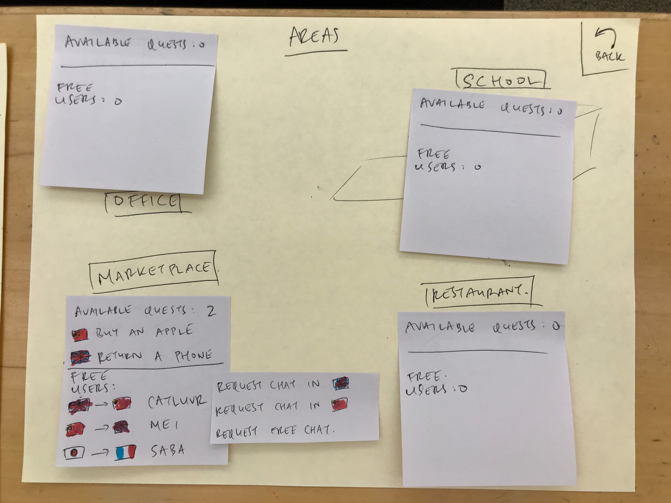
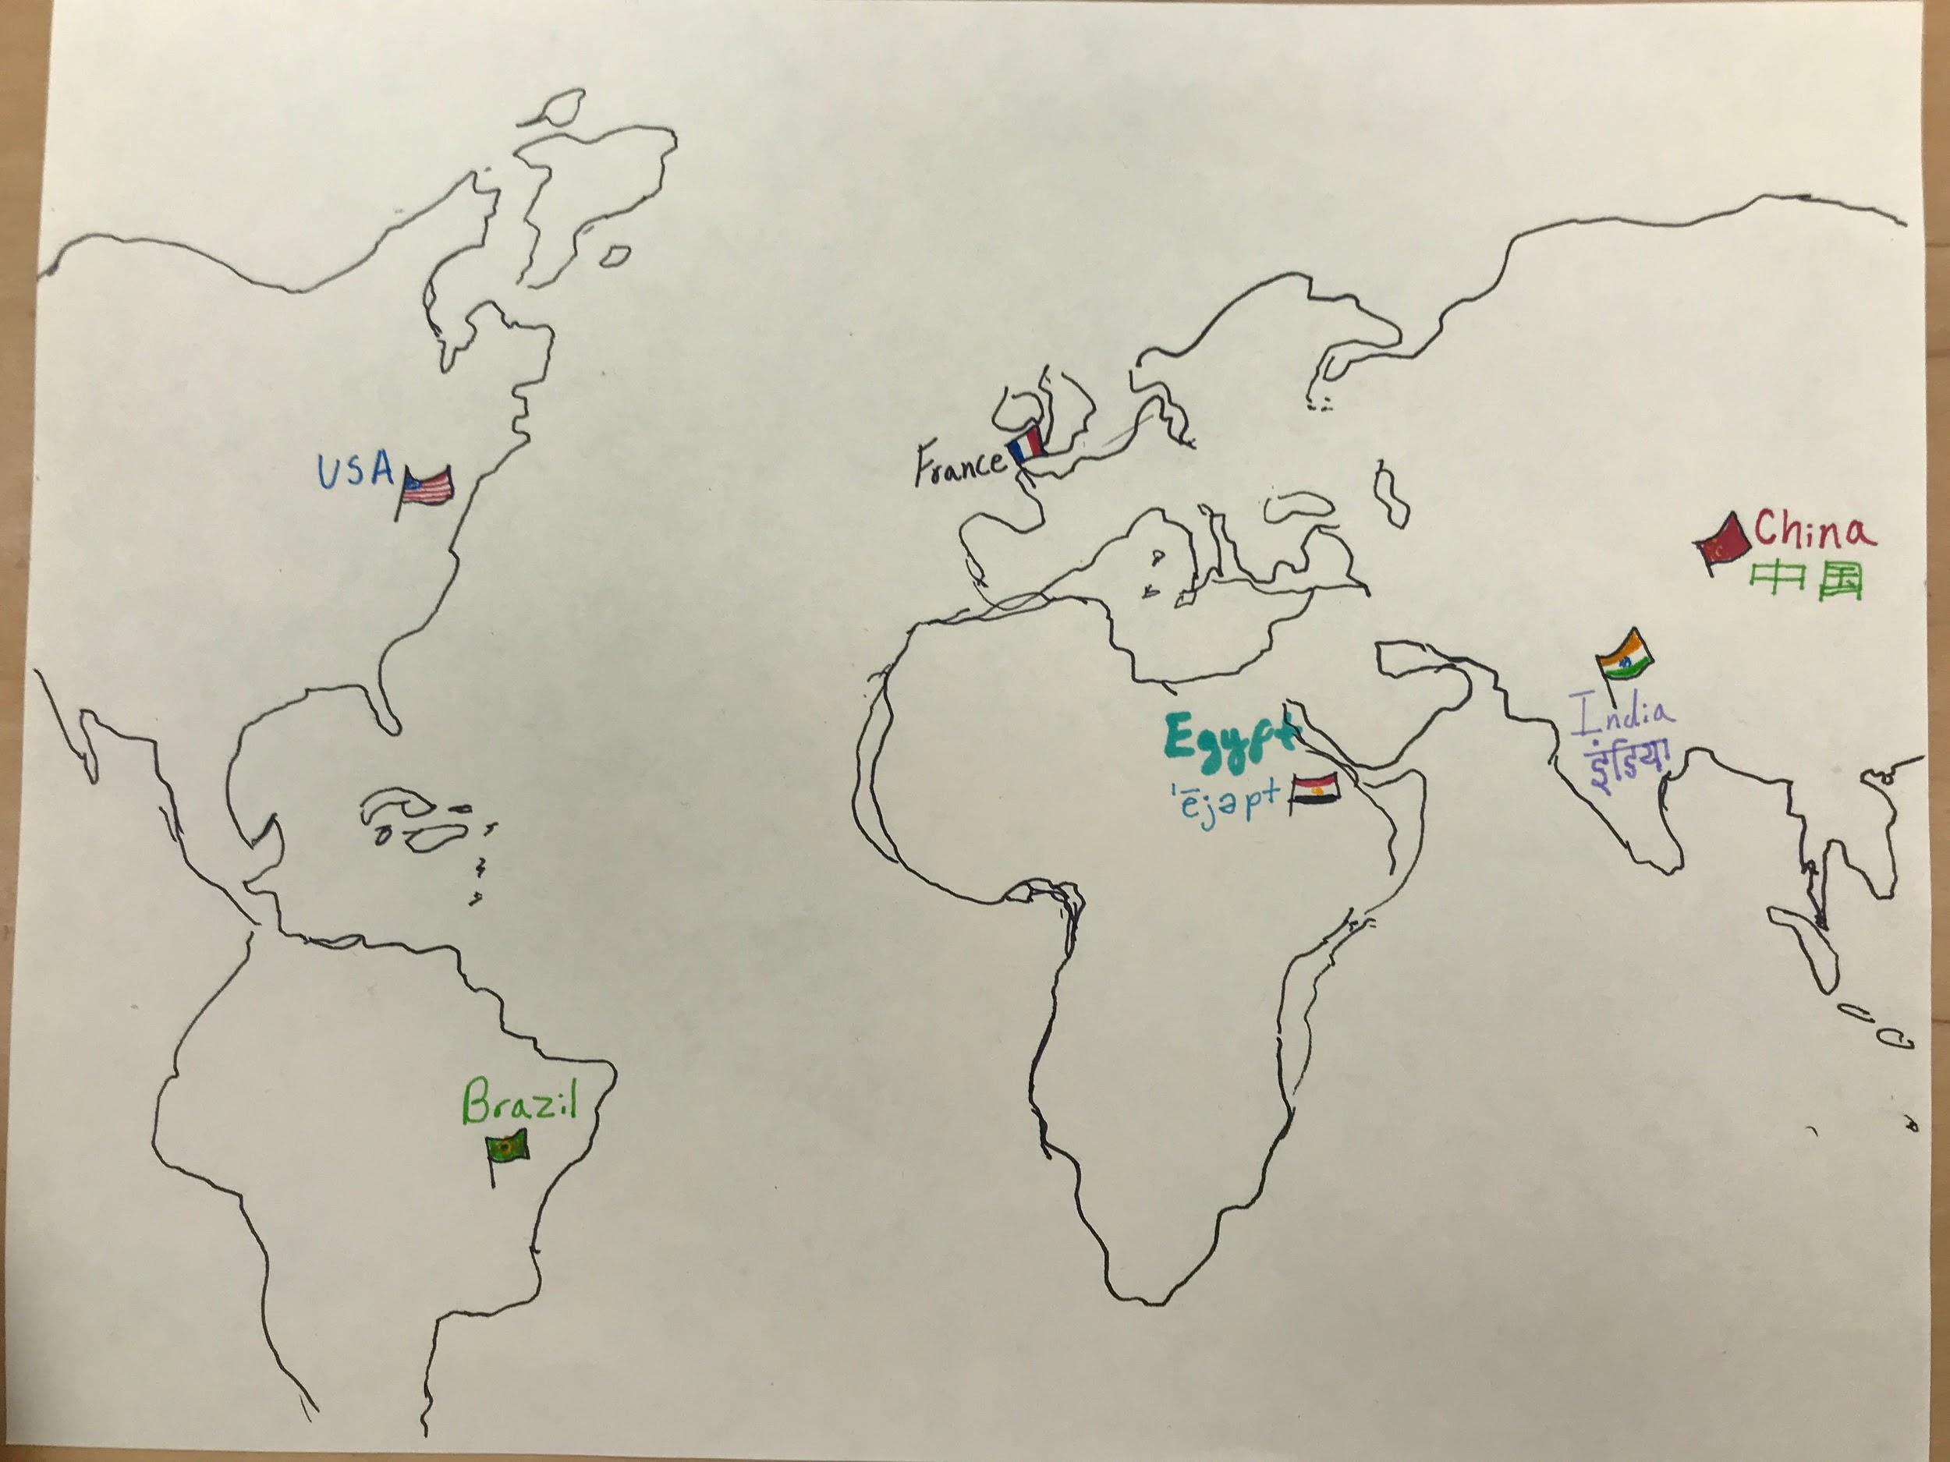
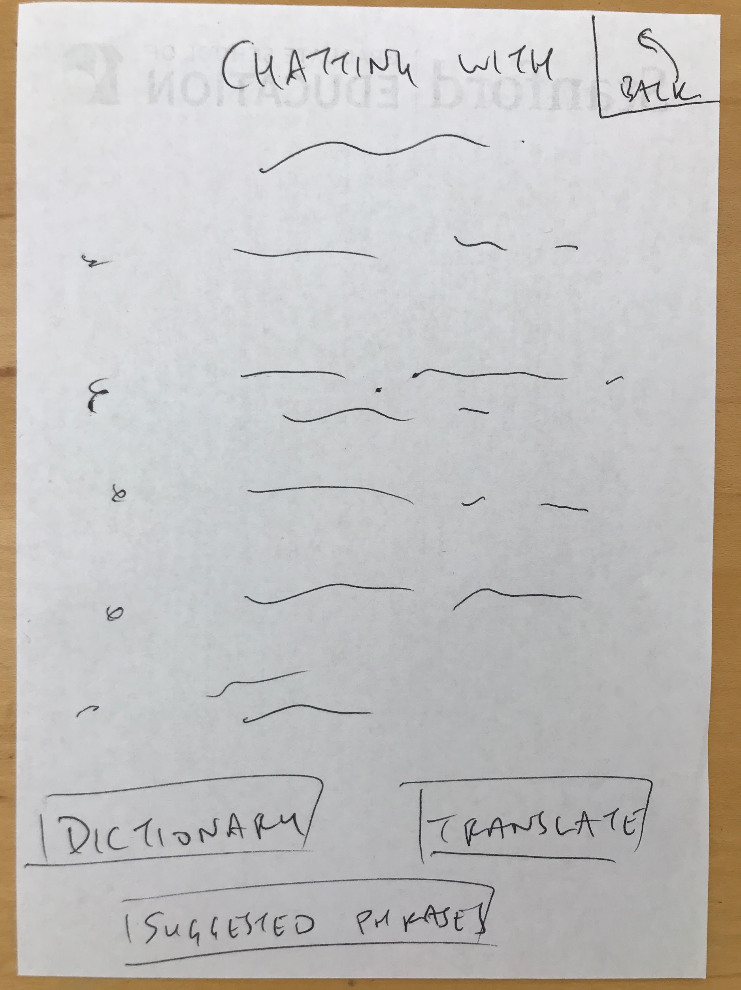
Task 1

Slide 13
UI Tasks Flows
Task 2 (moderate): Practice a real-world scenario in the target language in order to improve language skills

Slide 14
Task 2

Slide 15
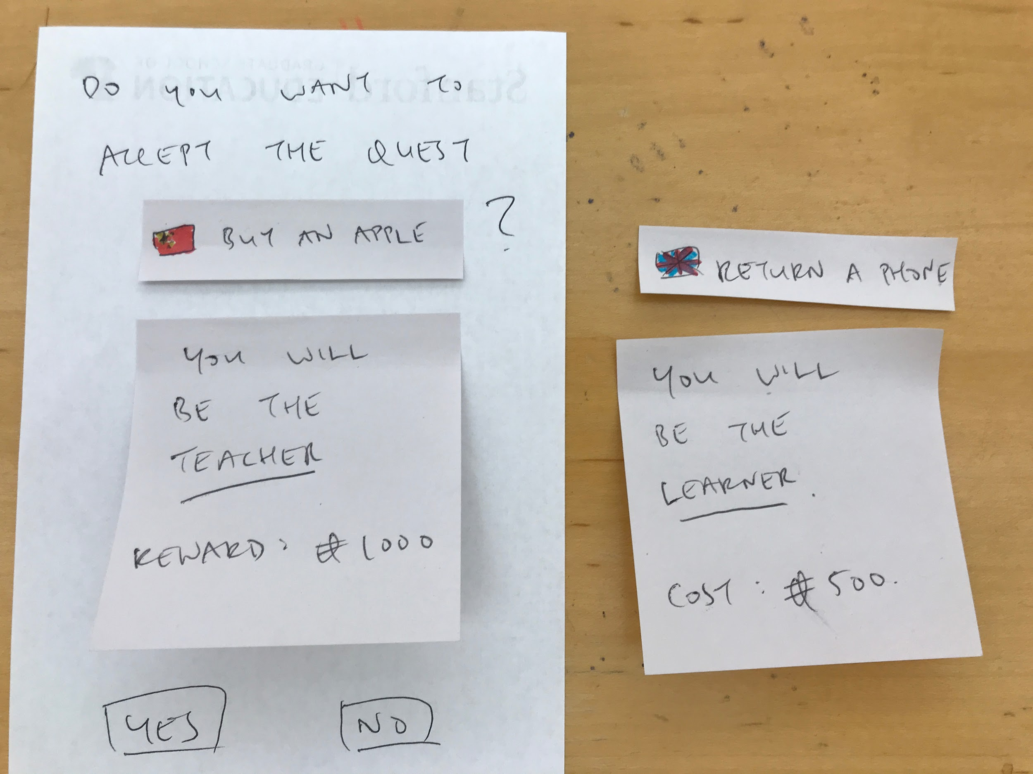
Task 2

Slide 16
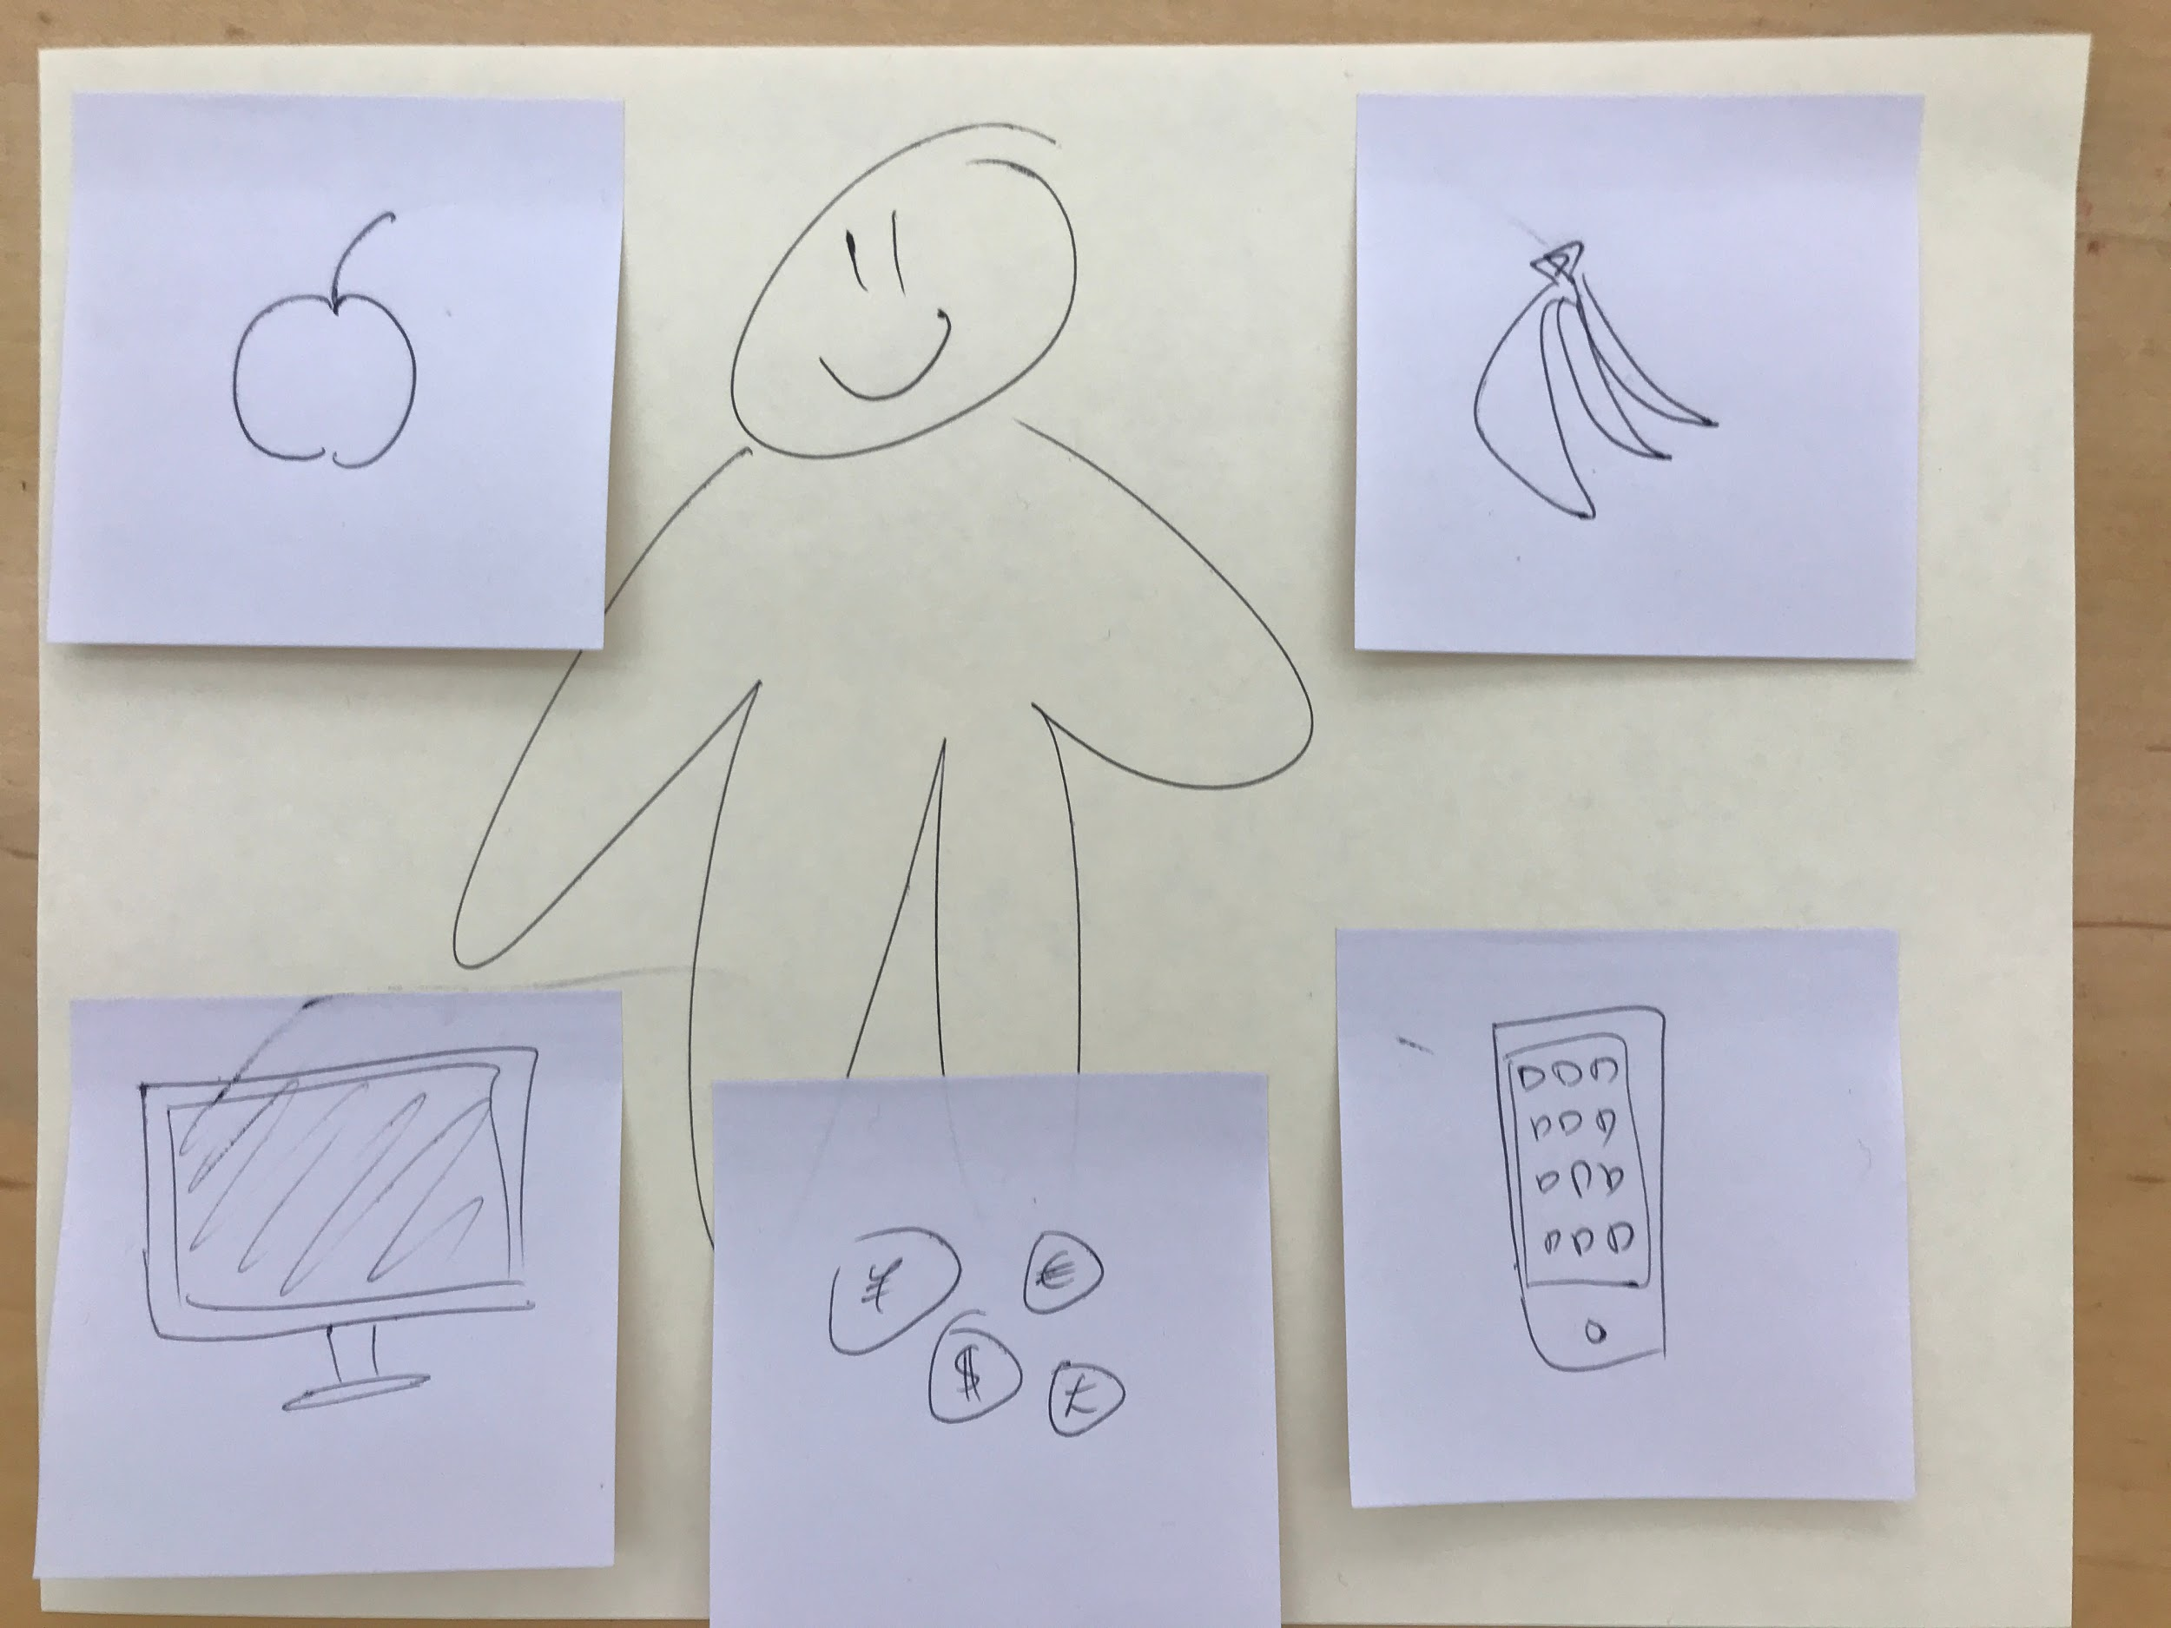
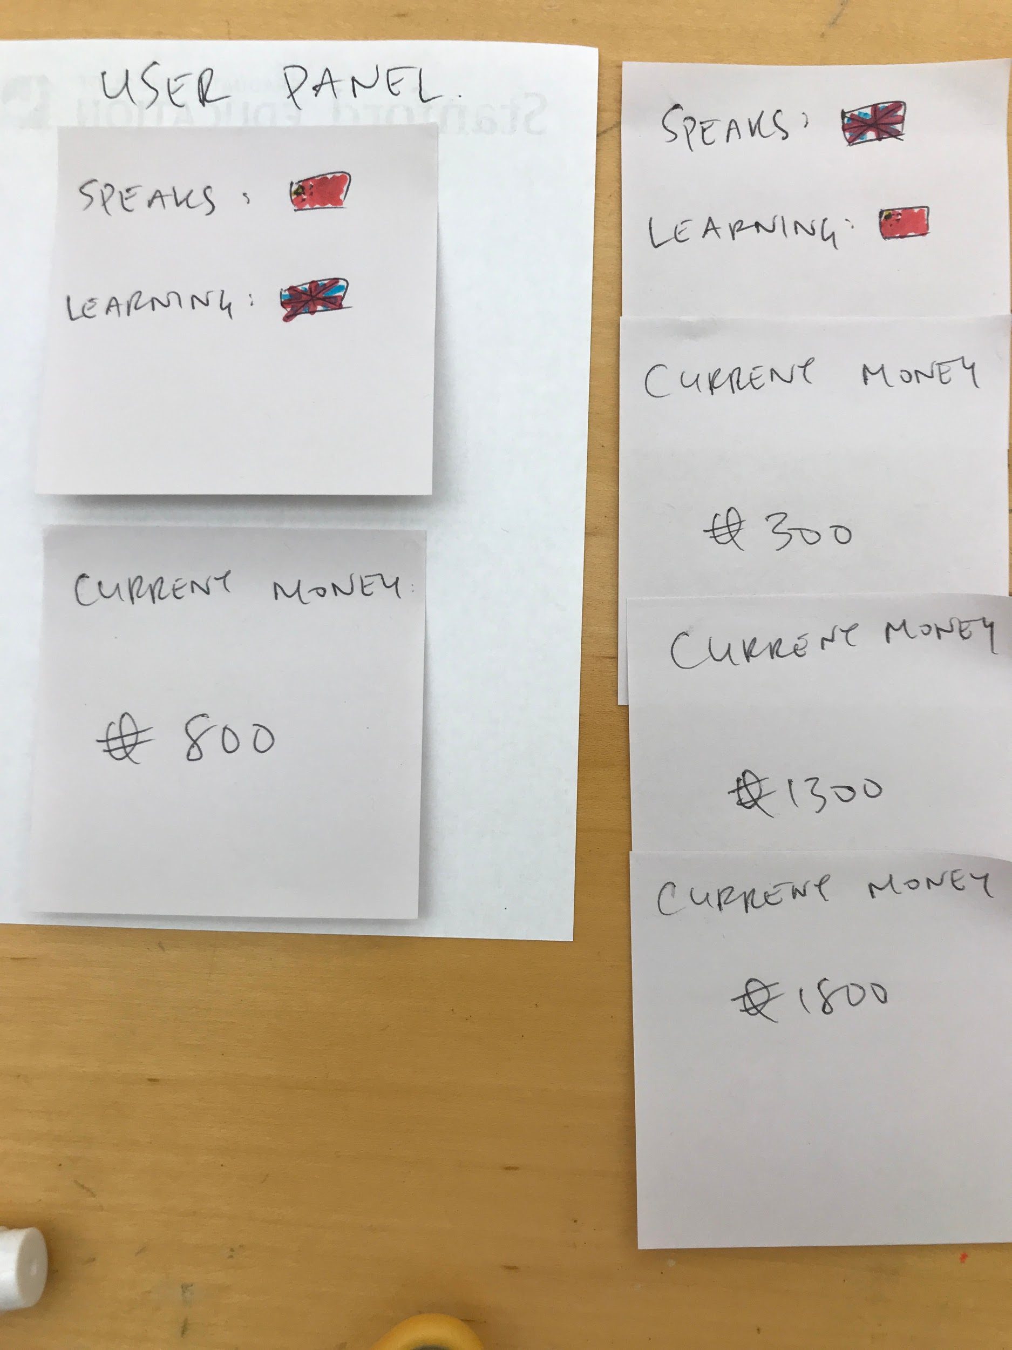
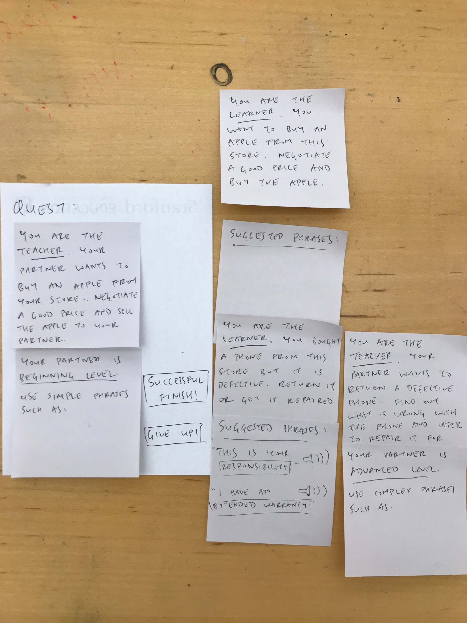
Task 2

Slide 17
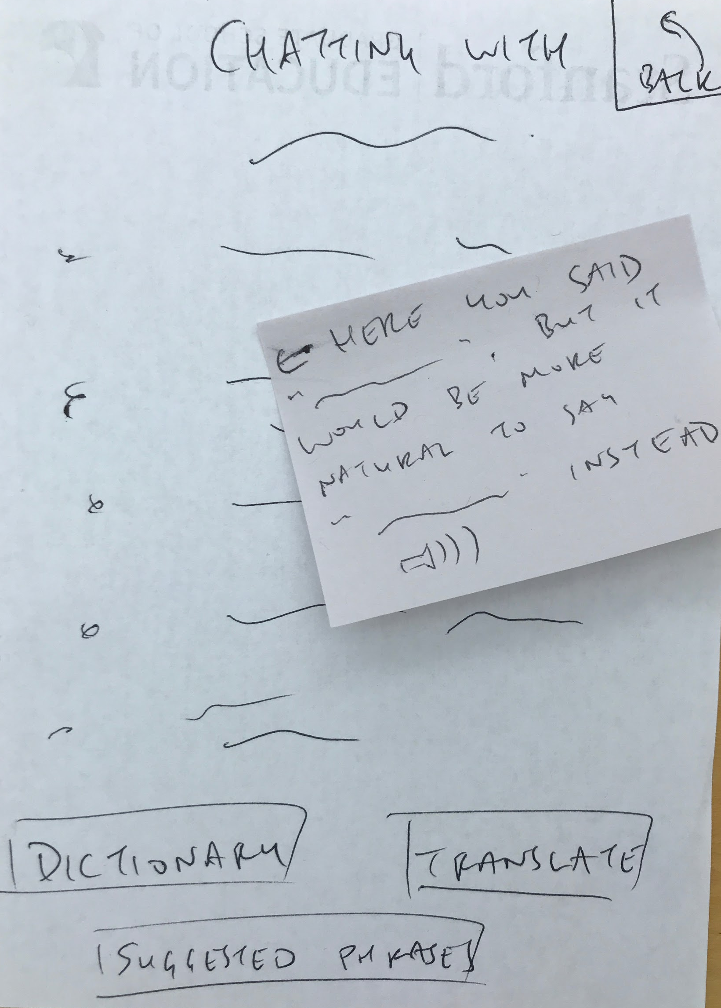
Task 2

Slide 18
UI Tasks Flows
Task 3 (complex): Help another user learn your native language

Slide 19
Task 3

Slide 20
Task 3

Slide 21
Task 3

Slide 22
Task 3

Slide 23
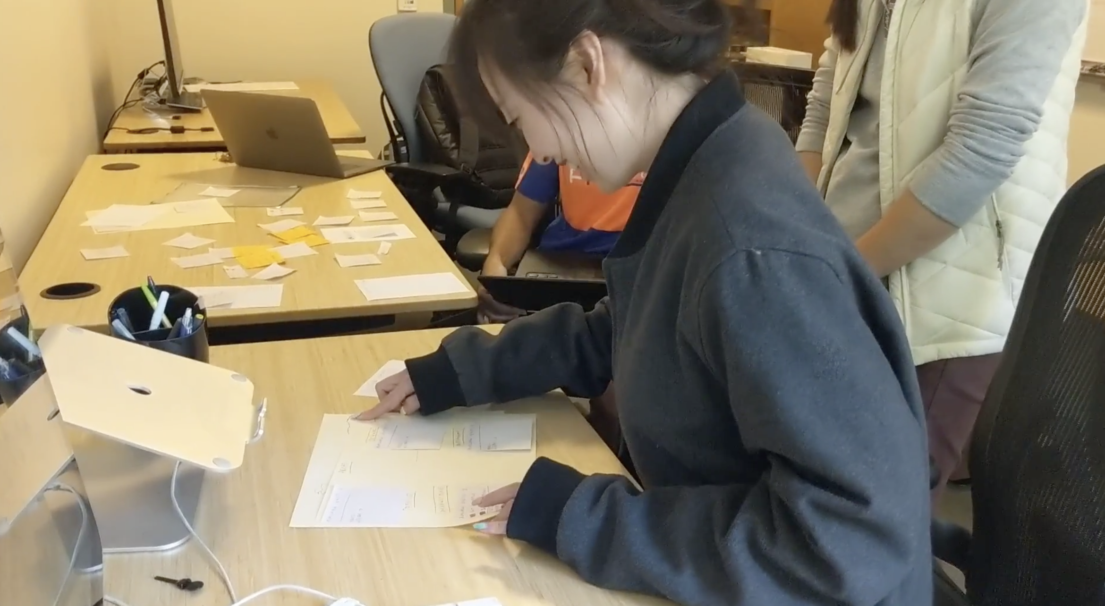
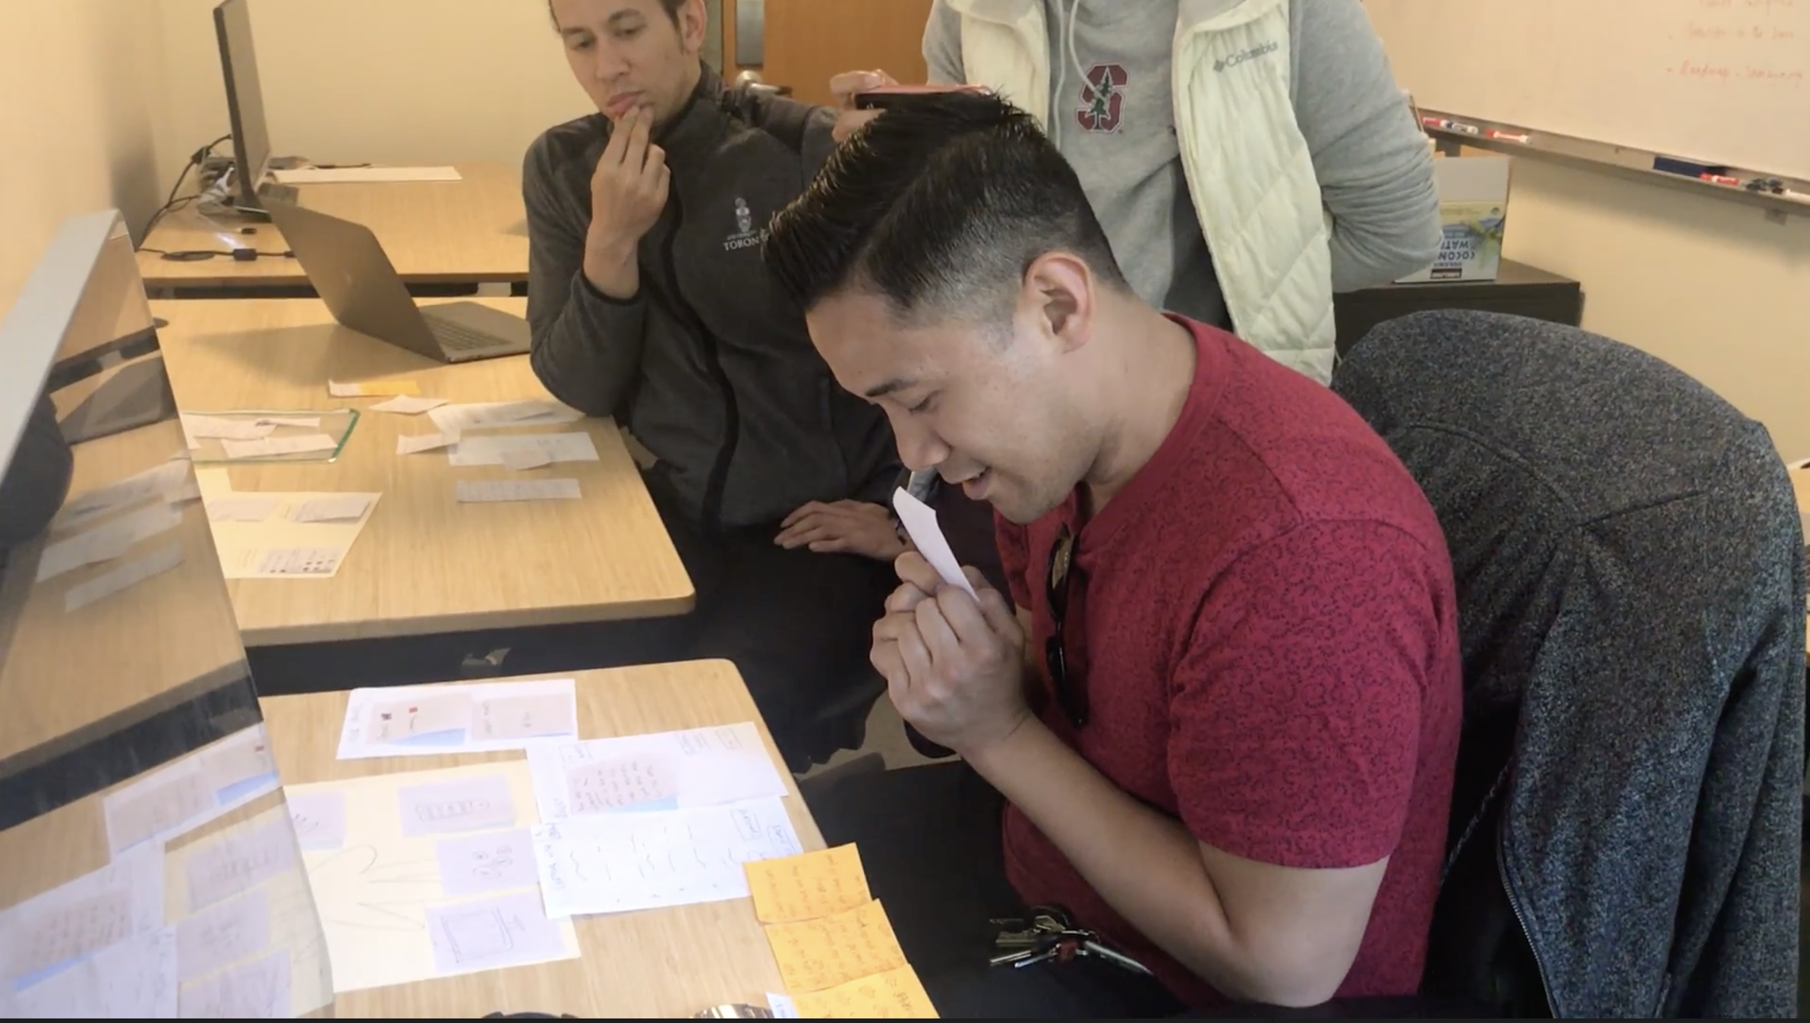
EXPERIMENT
Language pairs:
English -> Chinese, Chinese -> English
Tasks:
Chat with another user in your target language
Practice a real-world scenario in your target language
Help another user practice a real-world scenario in your native language

Slide 24
EXPERIMENT
Difficulties:
Impossible to give real-time feedback on language
Interface in non-native language is confusing
Not obvious whether partner is AI or another human user

Slide 25
iNSIGHTS
“If it’s an AI, I would feel a little more comfortable making mistakes”
“If it’s a real person, I would be a lot more conscious that I am wasting their time”
[translated from Chinese] “If the AI is smart enough, I’d prefer AI”
Ai OVER huMAN
Notes:
Insights:
Confusion around game mechanism
Preferring chatting with AI than real human
P1: “If it’s an AI, I would feel a little more comfortable making mistakes”
P1: “If it’s a real person, I would be a lot more conscious that I am wasting their time”
P2: [translated from Chinese] “If the AI is smart enough, I’d prefer AI”
Like the real-life immersive experience
P1: “Learning experience definitely felt safe”
P2: [translated from Chinese] “I like that it gives me a scenario and encourages me to speak English; regardless being correct or not, I speak more in these scenarios”
Different learning needs (may be related to proficiency level and preference)
P1: Opportunity to hear and imitate - learning through observation instead of direct engagement
P2: Immediate feedback to see mistakes
“I think it’d be great if I can see real-time feedback on the transcript where I made mistakes or if it offers me some suggestions so that I can express myself better and incorporate the feedback. But, of course, this is my ideal situation.”

Slide 26
iNSIGHTS
“If it’s an AI, I would feel a little more comfortable making mistakes”
“If it’s a real person, I would be a lot more conscious that I am wasting their time”
[translated from Chinese] “If the AI is smart enough, I’d prefer AI”
Ai OVER huMAN
“Learning experience definitely felt safe”
“I like that it gives me a scenario and encourages me to speak English; regardless being correct or not, I speak more in these scenarios”
lEARNING Environment
Notes:
Insights:
Confusion around game mechanism
Preferring chatting with AI than real human
P1: “If it’s an AI, I would feel a little more comfortable making mistakes”
P1: “If it’s a real person, I would be a lot more conscious that I am wasting their time”
P2: [translated from Chinese] “If the AI is smart enough, I’d prefer AI”
Like the real-life immersive experience
P1: “Learning experience definitely felt safe”
P2: [translated from Chinese] “I like that it gives me a scenario and encourages me to speak English; regardless being correct or not, I speak more in these scenarios”
Different learning needs (may be related to proficiency level and preference)
P1: Opportunity to hear and imitate - learning through observation instead of direct engagement
P2: Immediate feedback to see mistakes
“I think it’d be great if I can see real-time feedback on the transcript where I made mistakes or if it offers me some suggestions so that I can express myself better and incorporate the feedback. But, of course, this is my ideal situation.”

Slide 27
iNSIGHTS
“If it’s an AI, I would feel a little more comfortable making mistakes”
“If it’s a real person, I would be a lot more conscious that I am wasting their time”
[translated from Chinese] “If the AI is smart enough, I’d prefer AI”
AI OVER HUMAN
“Learning experience definitely felt safe”
“I like that it gives me a scenario and encourages me to speak English; regardless being correct or not, I speak more in these scenarios”
LEARNING ENVIRONMENT
“It would have been cool to be able to select two people and observe their conversation and just watch … As a person that doesn’t know much Chinese, I feel like I learn a lot from just observing and then imitating”
“I think it’d be great if I can see real-time feedback on the transcript where I made mistakes or if it offers me some suggestions so that I can express myself better and incorporate the feedback.”
DIFFERENT NEEDS
Notes:
Insights:
Confusion around game mechanism
Preferring chatting with AI than real human
P1: “If it’s an AI, I would feel a little more comfortable making mistakes”
P1: “If it’s a real person, I would be a lot more conscious that I am wasting their time”
P2: [translated from Chinese] “If the AI is smart enough, I’d prefer AI”
Like the real-life immersive experience
P1: “Learning experience definitely felt safe”
P2: [translated from Chinese] “I like that it gives me a scenario and encourages me to speak English; regardless being correct or not, I speak more in these scenarios”
Different learning needs (may be related to proficiency level and preference)
P1: Opportunity to hear and imitate - learning through observation instead of direct engagement
P2: Immediate feedback to see mistakes
“I think it’d be great if I can see real-time feedback on the transcript where I made mistakes or if it offers me some suggestions so that I can express myself better and incorporate the feedback. But, of course, this is my ideal situation.”

Slide 28
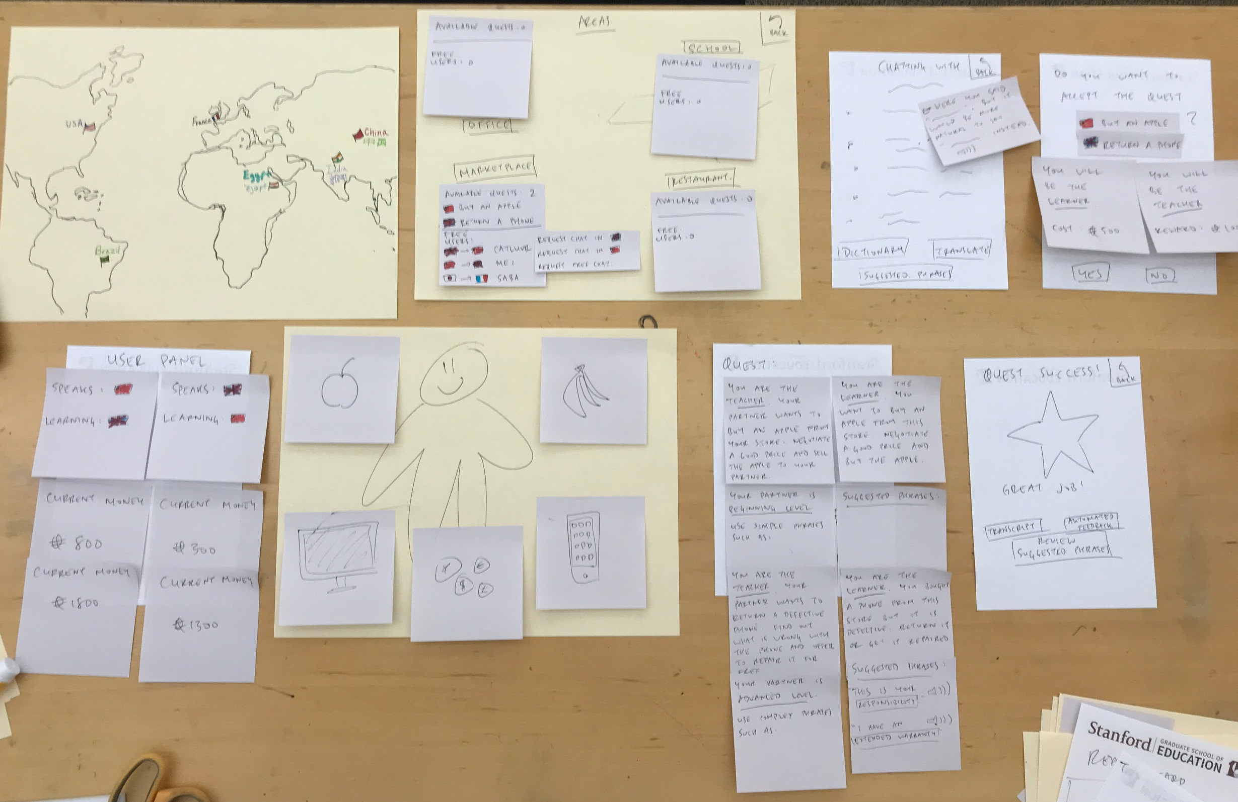
Full
Prototype
(Appendix)

